Slide 1
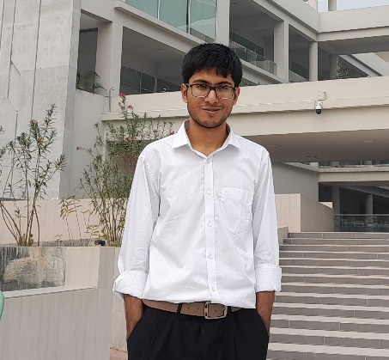
S M Zobayer Abedin
E-mail: zobayerabedin@gmail.com
Contact No : 01633193674
I am currently a CSE undergraduate in Khulna University of Engineering and Technology. I am very enthusiastic about solving problem and enjoy to learn new things which made me think.
Experience:
CodeChef Problems setter, Judge
January 2023 – February 2023(1 month)
One of the problem Setter in CodeChef Starter 73
Special Group Interested in Programming Contest(SGIPC)
President
February 2024 – Current
Batch Representative(19th batch)
February 2023 – January 2023(1 year)
Assistant Contest Manager
February 2022 – January 2023(1 year)

Slide 2
Education:
Khulna University of Engineering and Technology Bachelor of Engineering – BE, Computer Science and Technology(CSE)
(2019 - 2025)
Notre Dame College HSC (2017- 2019)
Galimpur Rahmania High School SSC (2017- 2015)
Awards-Achievement:
Intra KUET Programming Champion (2022)
Candidate Master(CM) in Codeforces
8th in ICPC Dhaka Regional (2023)
Master in Codechef

